Slide 1
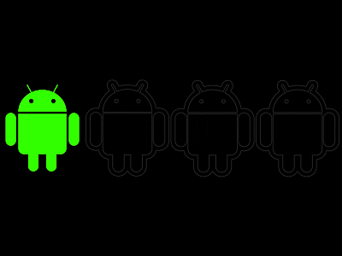

PERSONAL BUDGETING APP
MOBILE PRGORAMMING FINAL PROJECT REVIEW
Date= 29/9/2022
PRESENTED BY:
AVANTIKA (ENG20CA0005)
NANDINI GARG (ENG20CA0023)
PRATIK RAJ (ENG20CA0026)
SHREYA JAISWAL (ENG20CA0042)

Slide 2
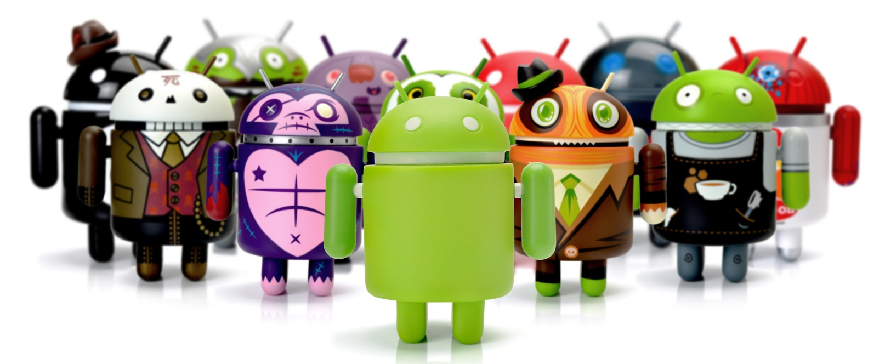
OVERVIEW
ABSTRACT
INTRODUCTION
OBJECTIVE
SOFTWARE AND HARDWARE REQUIREMENTS
PROBLEM STATEMENT
OUTPUT AND IMPLEMENTATION
CONCLUSION
REFERENCES

Slide 3
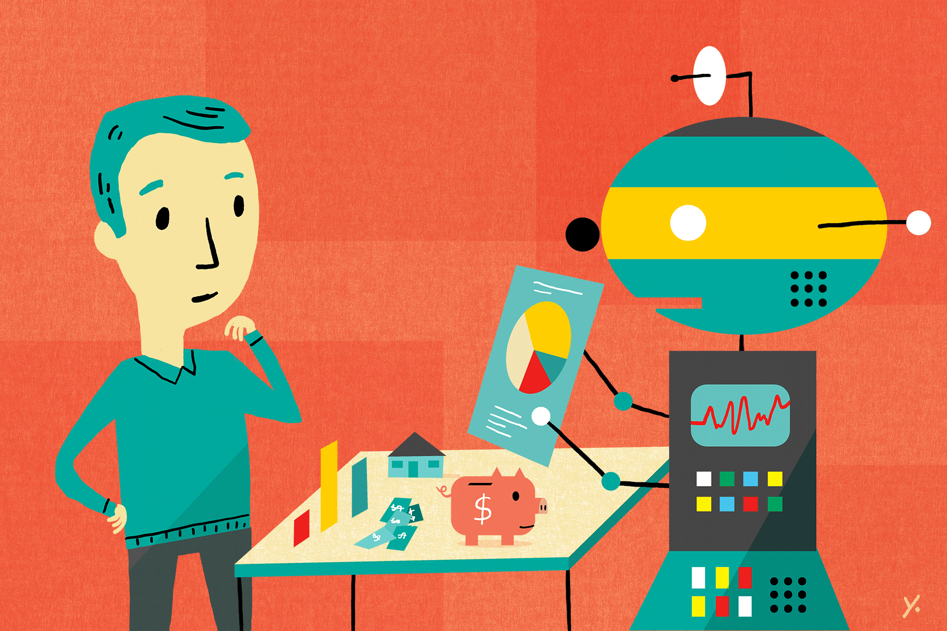
ABSTRACT
Basically, we can see that today everyone seek towards his savings. They want that in this era of inflation how they can control their expenses and save money for future use. Obviously, they are seeking towards such an application which guides them how they can meet their expenses in efficient manner and also save their money for future use.

Slide 4
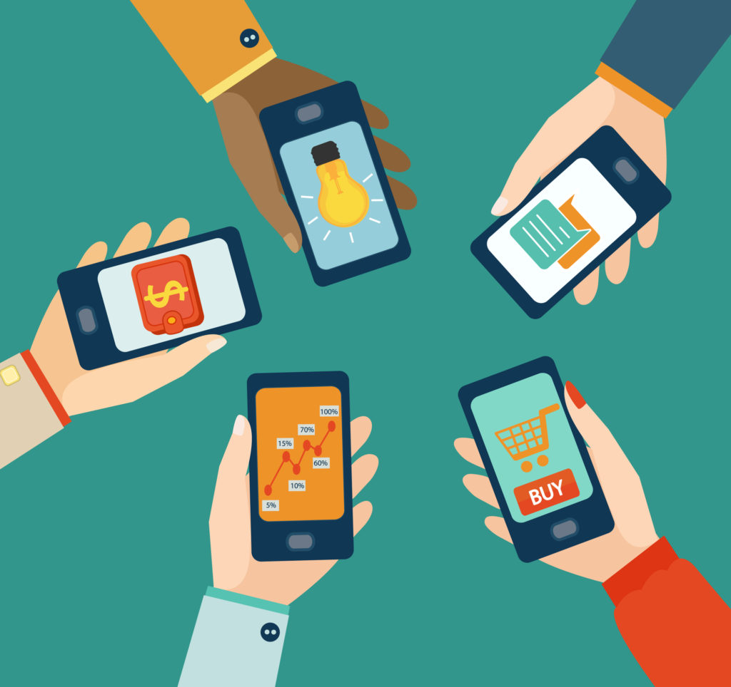
INTRODUCTION
This app is a budget manager application. This app will help user to keep track of their expenses. Getting your finances in order begins with tracking your spending and considering your budget. You can reduce your expenses by understanding what you spend money on and how much you spend. Also you can see your weekly and monthly budgets.
This system is made and supervised by the experts and satisfying by the user. XML, JAVA, SQLite database, Android Studio are used to develop the system. The system is tested by over 5 users, and 80% of them found the system useful.
THE User interface of the Daily Expense Tracker is very simple and attractive so it is easy to understand and the best way to record our financial data

Slide 5

Our goal is to create an expense tracking system where user can be tracking all financial activities and view previous income and expense report.
❖Users can easily review the reports daily, weekly, monthly or yearly.
❖Users can update or delete records.
❖Users can also modify some features.
❖Add Expense and Income

Slide 6




Software requirements
You will be able to understand Android Studio’s workings if you are familiar with them. The following technologies/tools are required for the project.
Java – The logic of the application will be written in Java.
XML – The designing portion of our application will be coded in XML.
Android Studio – We will be using android studio to create the apps.
SQLite – You should be familiar with SQLite. This will be used as a database.

Slide 7
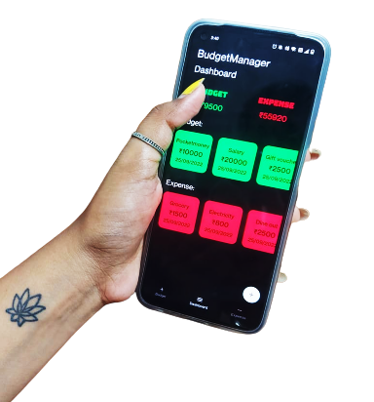
Problem statement: Many organizations have their own system to record their income and expenses, which they feel is the main key point of their business progress. It is a good habit for a person to record daily expenses and earning but due to unawareness and lack of proper applications to suit their privacy, lacking decision making capacity people are using traditional note keeping methods to do so. Due to lack of a complete tracking system, there is a constant overload to rely on the daily entry of the expenditure and total estimation till the end of the month. Solution: Personal Budgeting App

Slide 8
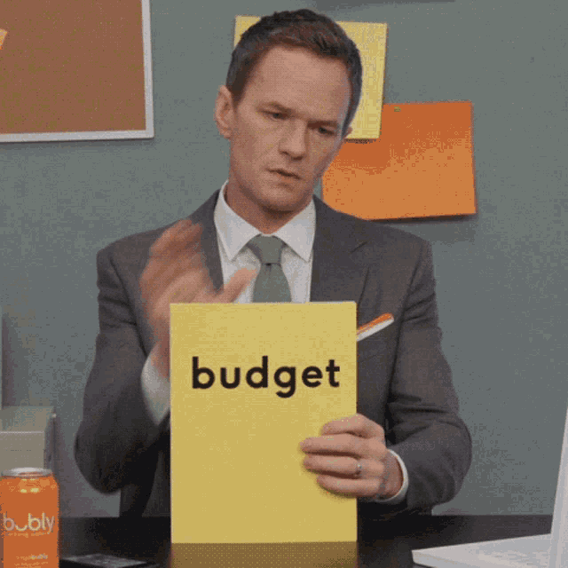
EXISTING SYSTEM
FINANCIAL LEDGERS WERE USED FOR BOOK KEEPING
LACK OF ACCURACY OF DATA
TIME AND SPACE CONSUMING PROCEDURE

Slide 9
Proposed system
This system is a bunch of benefits from various point of views. AS this application enables the end users to manage there budget personally.
This is a new application that will attract the public user through its features.
This is an Android-based mobile application, so if a user does not have an Android phone then this application will not help him

Slide 10
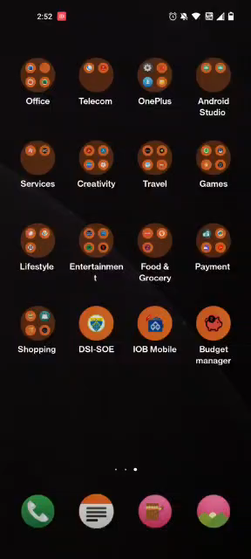

IMPLEMENTATION OF THE APP

Slide 11

CONCLUSION
After making this application we assure that this application will help its users to manage
the cost of their daily expenditure. It will guide them and make them aware about their
daily expenses. It will prove to be helpful for the people who are frustrated with their daily
budget management, irritated because of the amount of expenses and wish to manage
money and to preserve the record of their daily cost which may be useful to change their
way of spending money. In short, this application will help its users to overcome the
wastage of money.
REFERENCES
https://www.studocu.com/in/document/dr-apj-abdul-kalam technical-university/btech/mini-project-report/29935835
https://ieeexplore.ieee.org/document/8628070

Slide 12

Thank You

